Slide 1
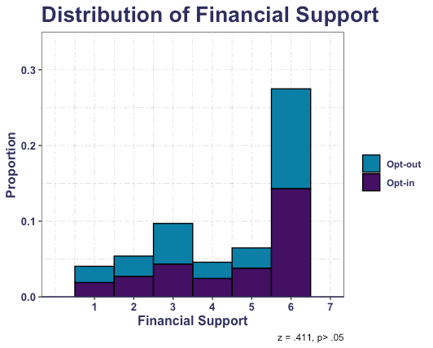
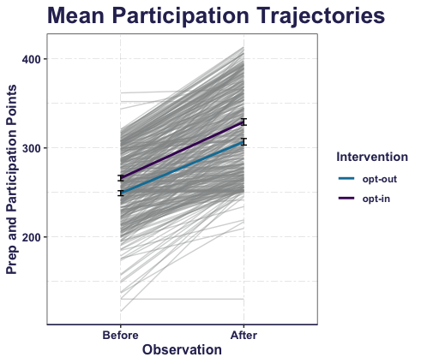

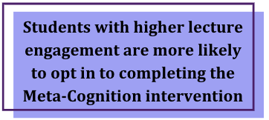
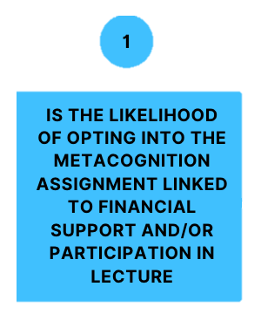
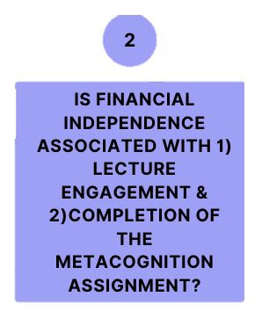
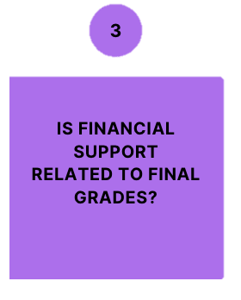
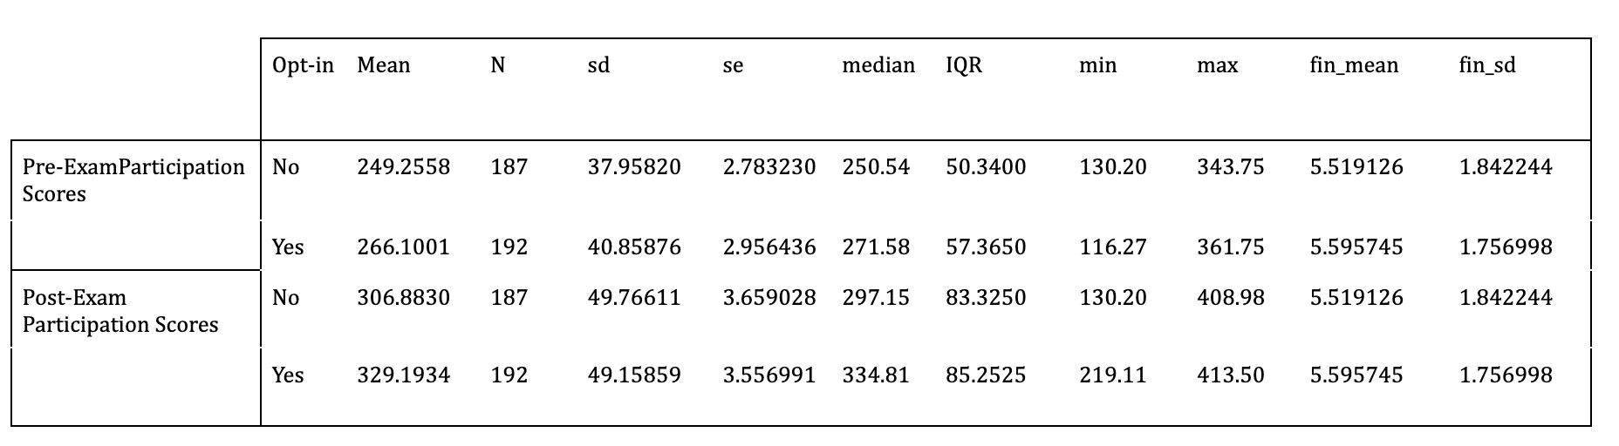
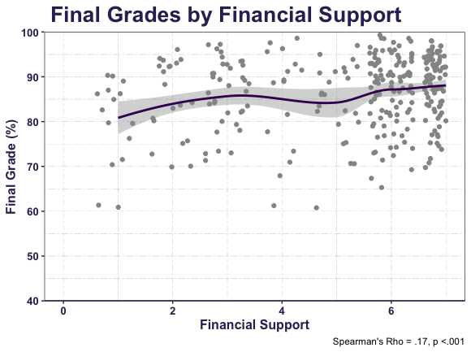
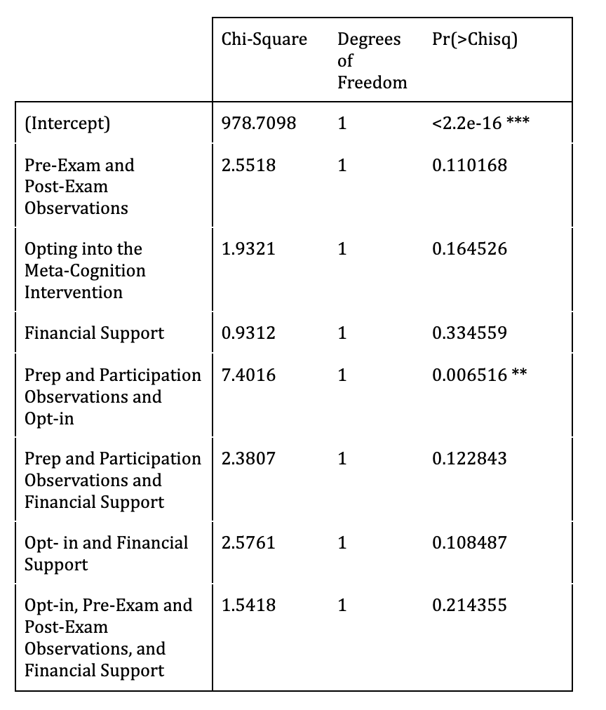

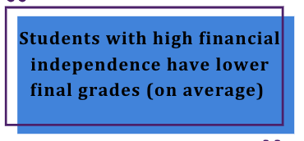
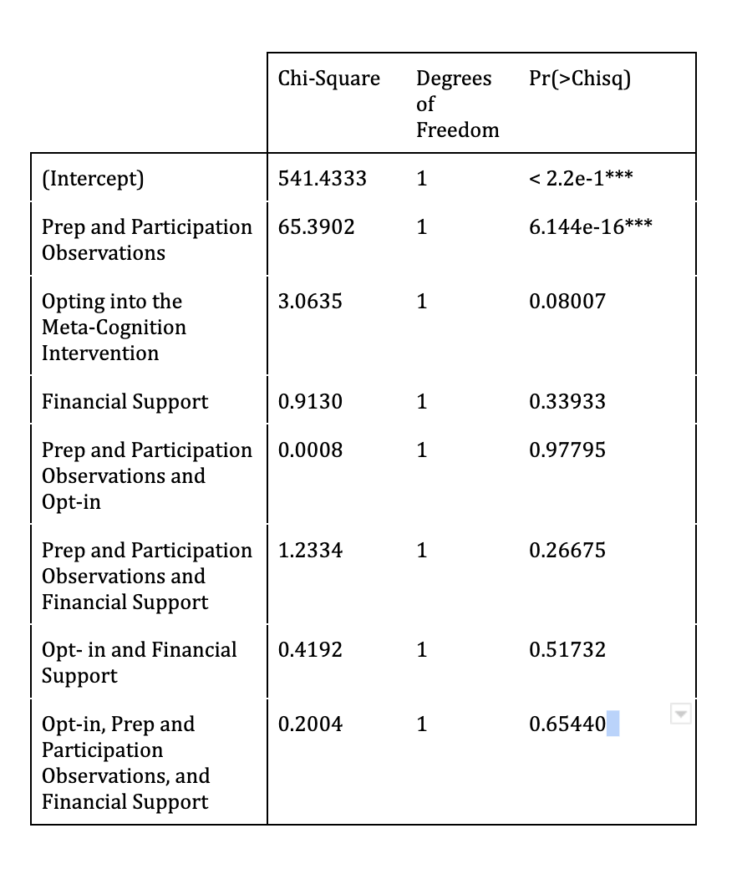
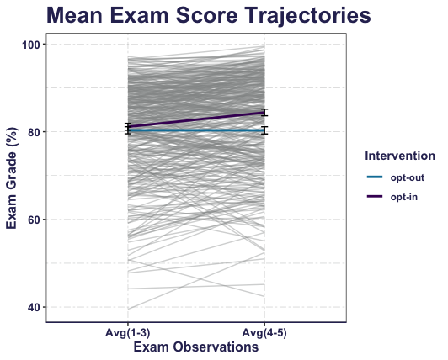
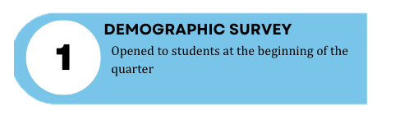
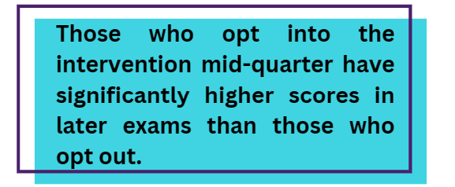
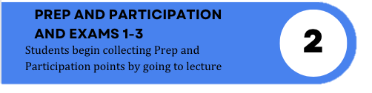
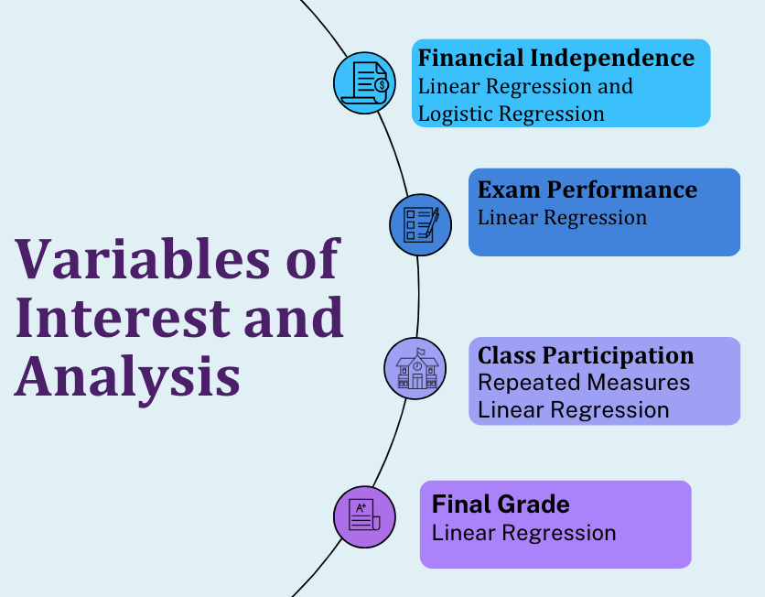

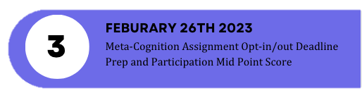
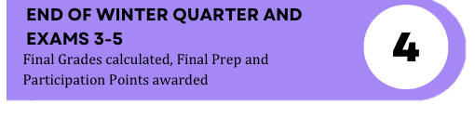
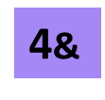
Thank
A
What are Predictors of Academic Success in Research Methods in Psychology?
Results suggest that students who opted into the Meta-Cognitive Intervention had better performance in later Exams than students who did not opt-in.
Want to Know More?
Authors: Laila Lawson, Sydney Wood, Victoria Cross
Background
Introduction to Research Methods in Psychology is a time consuming and information dense class that is consistently improve upon. Winter of 2023 an extra credit Meta-Cognition assignment was added to the curriculum. Our hypothesis considers the extra credit assignment’s efficacy and whether a student’s financial independence may impact engagement in this activity. We are interested in insuring equal opportunity and likelihood of academic success.
Literary Review Bivariate analyses show that students experiencing multiple insecurities were more likely to have anxiety/depression, fair/poor health, and lower mean GPA than those with basic needs security (Leung et. al 2021).
Using a fitted locally weighted regression model for GPA and hours worked, researchers found a positive association between GPA and hours worked until 5 hours hours per week (slightly more pronounced in part-time students), then a declining relationship between grades and working (flattening at 15h for part-time students and 10 hours for full time students) (Darolia 2014).
Questions of Interest
Table #1: Lecture Engagement by Opt-in
Table #2: Analysis of Exam Score Interactions
Conclusion #1:
Regardless of financial support there is no difference as to opting into the extra credit assignment χ²₅ = 0.93, p > .01.
Conclusion #2:
Students who opted into the Meta-Cognition intervention had better final grades (M = 87.9 % , SD = 8.37%, Median = 90.4%, IQR = 9.29% ) than those who opted out (M = 85.0 % SD = 10.3%, Median = 86.4 %, IQR = 12.5 %)
Methods
Students (N=379) completed a Demographic Survey, during Winter Quarter of 2023. The question of interest states “How much financial aid are you currently receiving?” referring to caregivers, parents, or guardians (scale 1-7, 1=no support, 7-fully supported). Exam grades and class participation were collected via Canvas scores. At the end of the quarter, Final Scores and overall lecture participation were assessed.
Conclusion #3:
There is little difference in participation effort demonstrated between students who opted-in (Median = 276.94, IQR = 77.52) vs those who opted-out (Median = 288.25, IQR = 84.08) of the intervention.
Table #3: Analysis of Lecture Engagement Interactions
References:
Rajeev Darolia, “Working (and studying) day and night: Heterogeneous effects of working on the academic performance of full-time and part-time students” ,Economics of Education Review, Volume 38, 2014, Pages 38-50, ISSN 0272-7757
Leung, C.W. et al. (2021) Understanding the cumulative burden of basic needs insecurities ... American Journal of Health Promotion. Available at: https://journals.sagepub.com/doi/10.1177/0890117120946210
Timeline of Data Collection
Notes:
Notes:
In Powerpoint, click View > Guides
Keep text within gutter guides.
Author list: Don’t split names onto two lines (e.g., “Jimmy [break] Smith”). If that happens, use a new line, unless you need the space. Bold the first names of anybody who’s presenting in person.
Intro/methods/result: Do not drop below font size 28, but if you have extra space, jack up the font size until the space is full.
Do not use color in the sidebars except in graphs/figures. It’ll pull attention from the center and slow interpretation for passersby.

